Slide 1
Model-Integrated Computing Design Principles for Biomedical Engineering Applications
William Banks

Slide 2
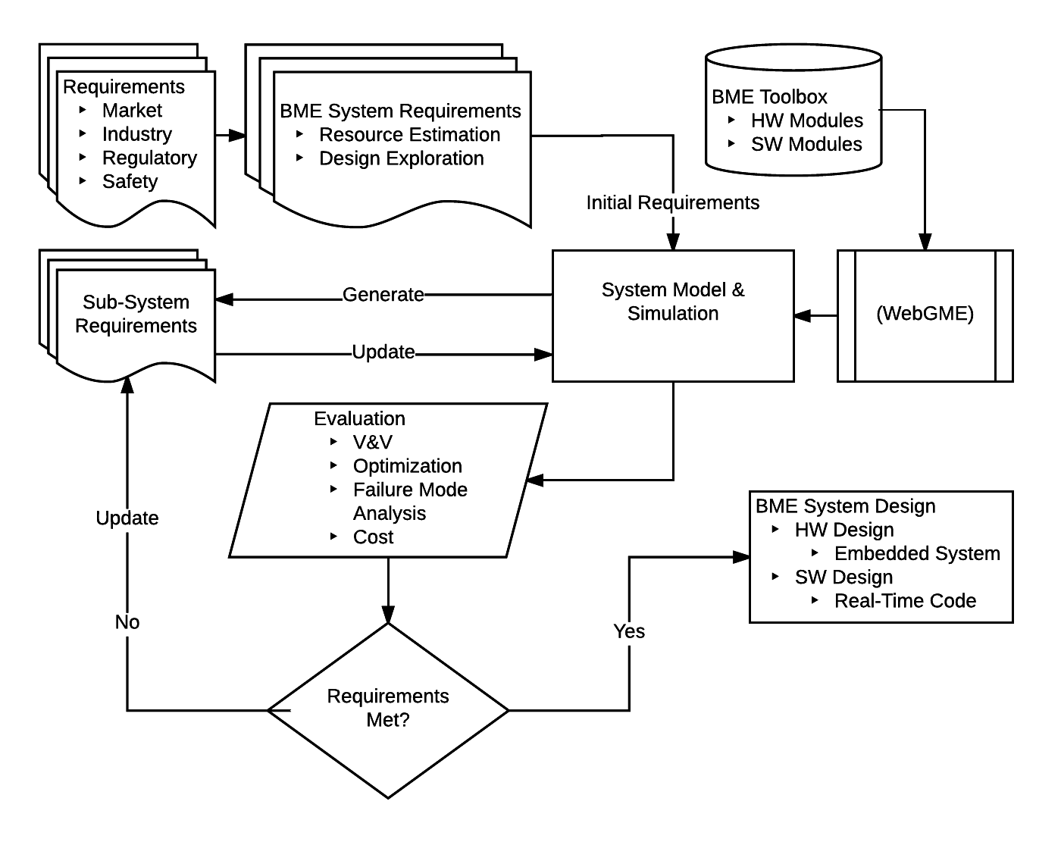
BME MIC design flow

Slide 3
Goals/Milestones
Assess current DSMLs for BME applications
Develop DSML for BME applications that incorporates regulatory and industry requirements as attributes of components.
Focus on design space and constraint modeling, safety, risk analysis
Identify attributes and attribute values unique to BME
Develop a library of components
Use components to design application (closed feedback system: insulin pump, data recorder-to--MD, venous pressure monitor, etc.)
Show that modeling can be used to refine the design through recursive requirement updates: Sys. Reqs→Model→V&V→ Sub-Sys. Reqs.→ Model→ V&V→. . . . →Design
Self-documentation of performance progression, safety and regulatory pathway
Establish method to expand component library

Slide 4
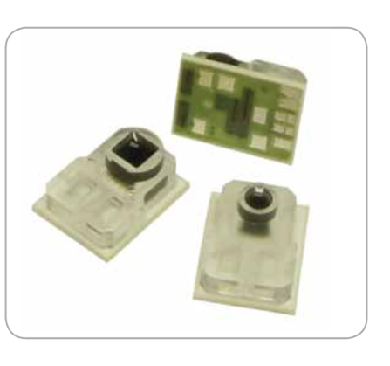
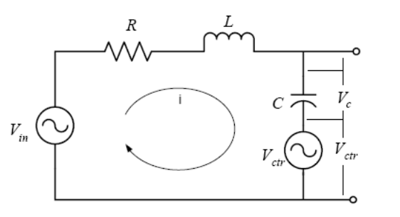
Example model: blood pressure measurements
Modelica
LT-Spice
Sensor Interface
Hydraulics
Pressure Transducer
NPC-100/120
Sensor
Bridge circuit
Sensitivity
datasheet
Physiological Model
RCL abstraction
Sensor Readout
Electronics

Slide 5





Example model: venous system sensor interface abstraction
$A0sin⁡(ω$t)
$$r1$$
$$P\left(t\right)1$$
$$r2$$
$$P(t)2$$
Objective: model simple fluid system in Modelica to represent a catheter transducer system to measure blood pressure
A piston pump connected to a tank via 2 pipes of different diameters
A latch on the top pipe opens outward with positive pressure and closes in equilibrium or negative pressure
P(2)₂ is the pressure as measured in a catheter

Slide 6
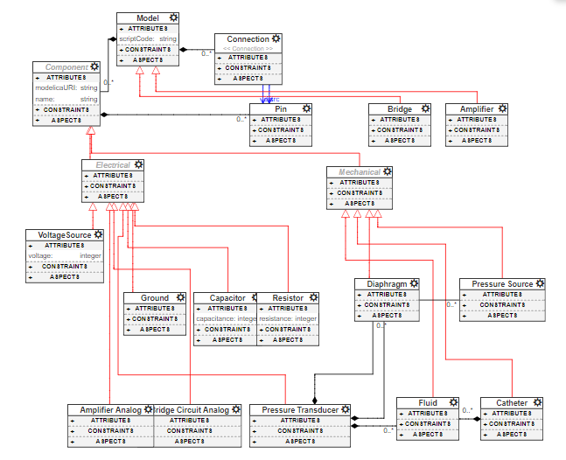
WebGME
To Do:
Modelica translator plugin
Not reading connections
Refine components and integrate other Modelica components

Slide 7
Goals/Milestones Revisited
Assess current DSMLs for BME applications
Develop DSML for BME applications that incorporates regulatory and industry requirements as attributes of components.
Focus on design space and constraint modeling, safety, risk analysis
Identify attributes and attribute values unique to BME
Develop a library of components
Use components to design application (closed feedback system: insulin pump, data recorder-to--MD, venous pressure monitor, etc.)
Show that modeling can be used to refine the design through recursive requirement updates: Sys. Reqs→Model→V&V→ Sub-Sys. Reqs.→ Model→ V&V→. . . . →Design
Self-documentation of performance progression, safety and regulatory pathway
Establish method to expand component library

Slide 8
Questions?

